Slide 1
Data Visualization
Visualizations help identify:
Distribution
Outliers
Trends
Relationships

Slide 2
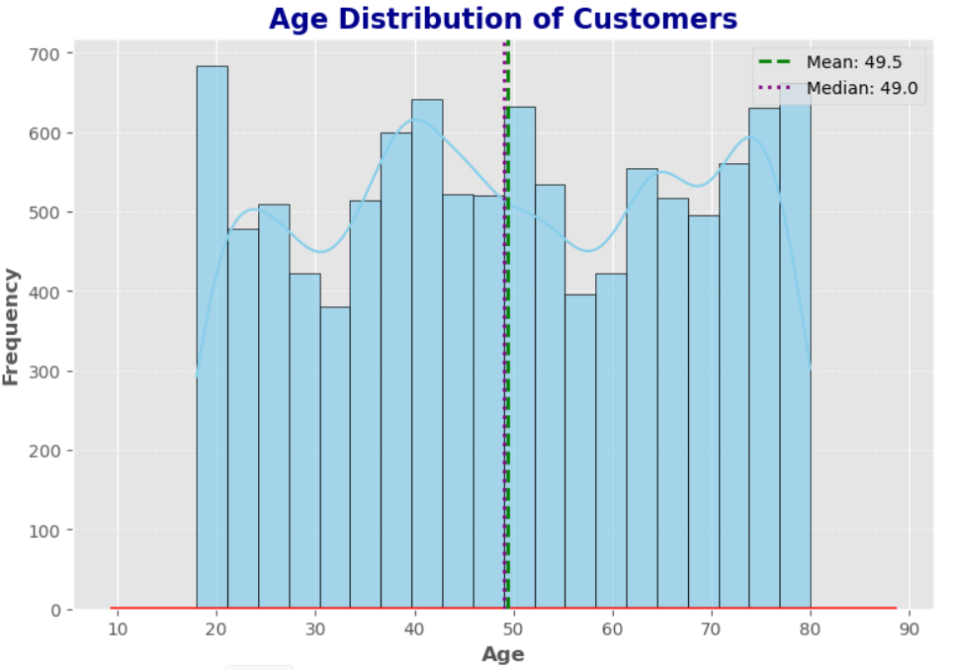
Age Distribution Insights
Central Tendency
Mean age ≈ 49.5 years
Median age ≈ 49.0 years
The closeness of mean and median indicates a fairly balanced distribution without strong skew.
Spread
Ages range widely (approx. 10–90 years), reflecting diverse demographics.
The distribution is concentrated around middle age, with fewer customers at the extremes.
Business Implications
Middle-aged customers form the core segment — marketing strategies should prioritize this group.
Younger and older age brackets are smaller but may represent niche opportunities (e.g., youth-focused offers or senior benefits).
Balanced distribution suggests segmentation by age bands could yield actionable insights for personalization.

Slide 3
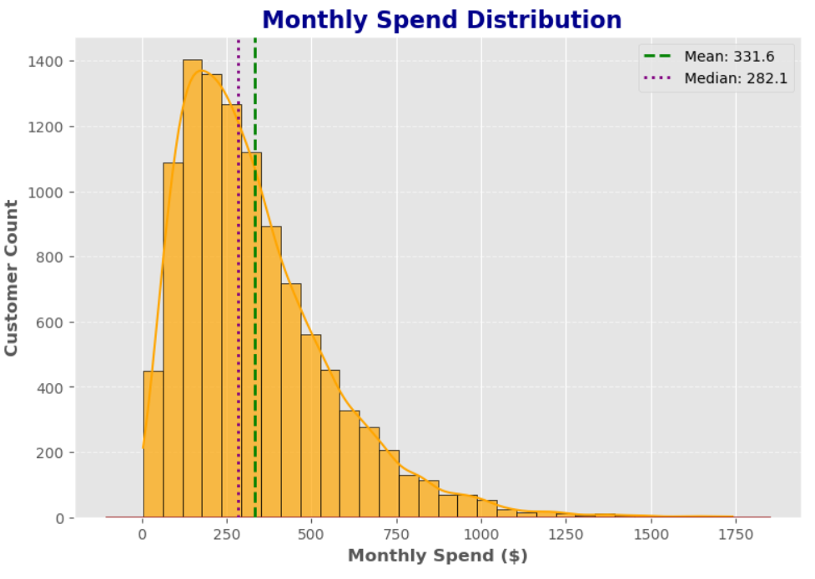
Monthly Spend Distribution Insights
Central Tendency
Mean spend = USD 331.6
Median spend = USD 282.1
The mean is noticeably higher than the median, indicating a right-skewed distribution — a few high-spending customers are pulling the average upward.
Spread
Most customers spend between 0-500, with a peak around 200-250.
A smaller group spends significantly more, creating a long tail in the distribution.
Business Implications
Majority of customers are low-to-mid spenders, forming the core revenue base.
High-spending customers, though fewer, contribute disproportionately to overall revenue — they represent a premium segment worth nurturing.
Skewness suggests opportunities for tiered loyalty programs or differentiated offers to maximize value across segments.

Slide 4
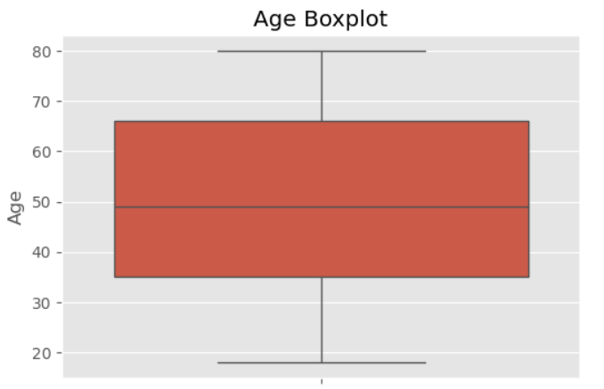
Age Distribution — Boxplot Analysis
Median Age (~50 years): The central line indicates that half of the population is younger than 50, while the other half is older.
Interquartile Range (IQR ~35–65 years): Most individuals fall within this middle spread, showing the typical age range of the dataset.
Whiskers (~18–80 years): These extend to the minimum and maximum non-outlier values, highlighting the broader age span.
Outliers: Any points beyond the whiskers suggest unusually young or old individuals compared to the majority.

Slide 5
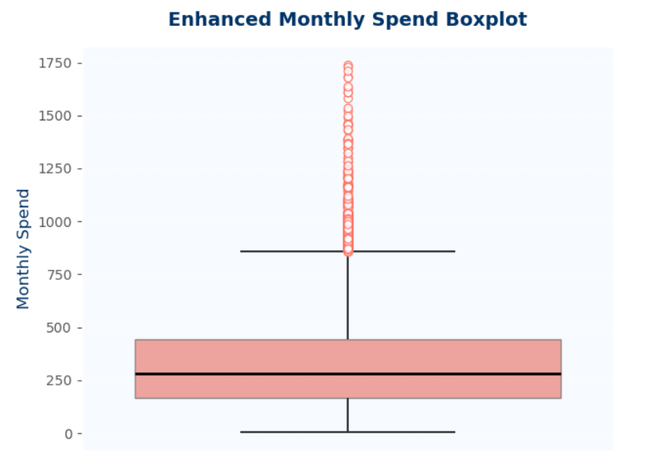
Monthly Spend — Boxplot Insight
Median Spend (~300): Indicates that half of the customers spend below $300 monthly, while the other half spend more.
IQR (Interquartile Range <500): Most customers fall within this range, showing a concentrated spending pattern among the majority.
Outliers (up to ~1750): A few customers spend significantly higher amounts, representing premium or high-value segments.
Distribution Shape: The presence of multiple outliers and a long upper whisker suggests a right-skewed distribution, meaning a small group drives higher revenue.

Slide 6
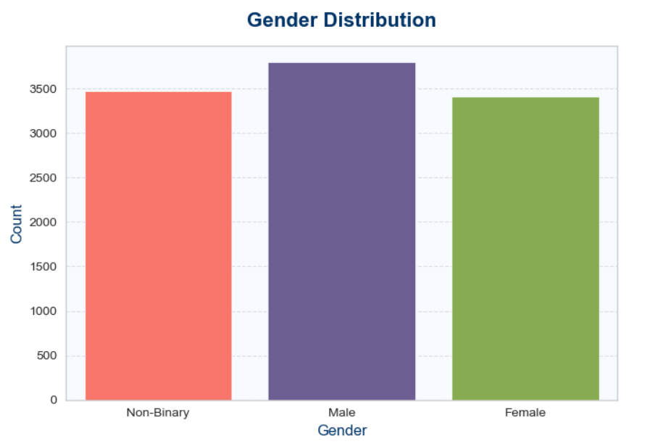
Gender Distribution — Analytical Insight
Male (~3700): Largest segment, slightly higher than other groups.
Non-Binary (~3500): Strong representation, nearly equal to female counts.
Female (~3400): Slightly lower but still a significant proportion.
Key Observations:
The dataset shows a balanced distribution across genders, with no single group overwhelmingly dominant.
The presence of a substantial non-binary segment indicates inclusivity and diversity in the customer base.
Differences between categories are relatively small, suggesting that gender-based segmentation alone may not be a strong differentiator.

Slide 7
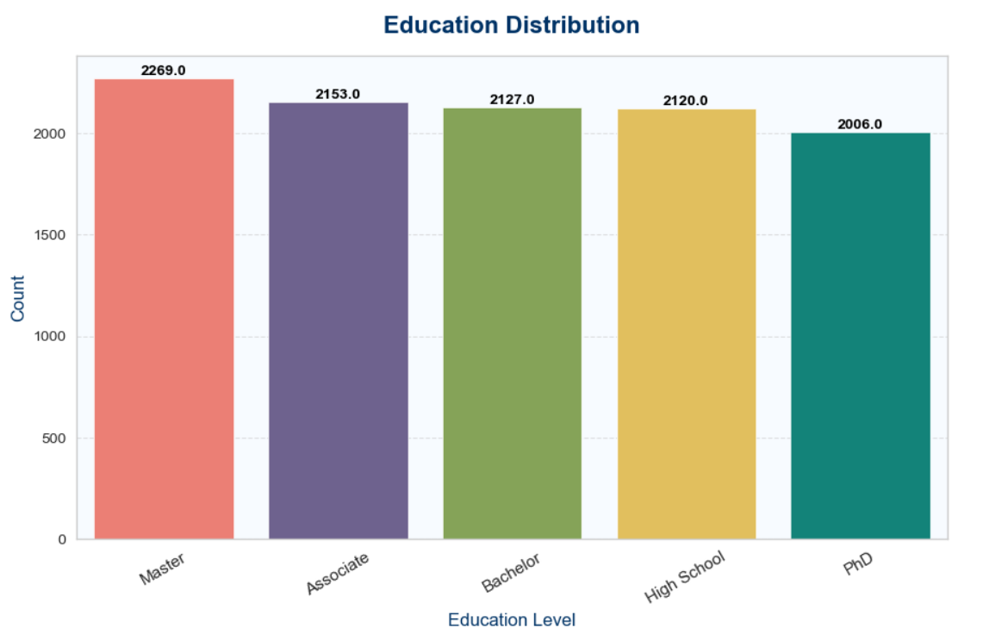
Education Distribution — Analytical Insight
Master (21.26%) → Largest segment, indicating a strong presence of highly educated individuals.
Associate (20.17%) & Bachelor (19.93%) → Together form nearly 40% of the base, representing mid-level education groups.
High School (19.86%) → Comparable to Bachelor, showing balanced representation of foundational education.
PhD (18.79%) → Smallest group, but still significant, highlighting advanced academic achievers.
Key Observations:
The distribution is fairly balanced across all categories, with no extreme dominance.
A slight skew toward Master’s degree holders suggests a customer base with higher education attainment.
The presence of substantial PhD and High School segments indicates diversity in educational backgrounds.

Slide 8
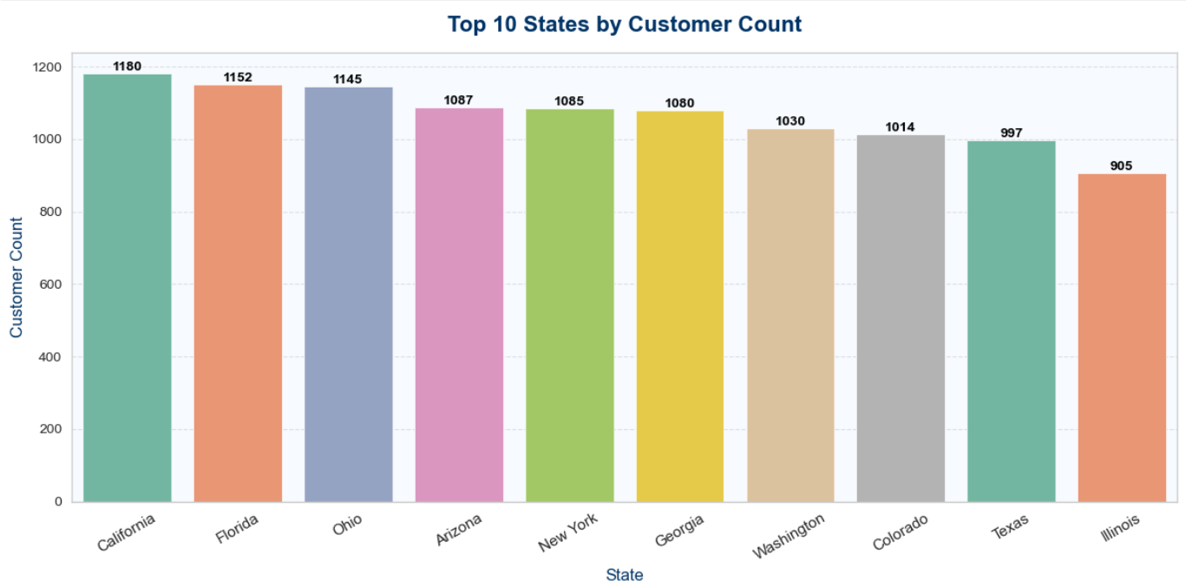
Top 10 States — Customer Distribution Insight
California (1180) → Largest customer base, a key market for targeted campaigns.
Florida (1152) & Ohio (1145) → Strong presence, nearly equal to California, forming secondary hubs.
Arizona (1087), New York (1085), Georgia (1080) → Mid-tier states with consistent customer counts.
Washington (1030) & Colorado (1014) → Solid representation, potential for regional growth.
Texas (997) → Slightly below 1000, still a significant contributor.
Illinois (905) → Lowest among the top 10 but remains an important market.

Slide 9
Top 10 States — Customer Distribution Insight
Key Observations:
The distribution is fairly balanced, with most top states contributing ~900–1200 customers.
California leads, but the margin over Florida and Ohio is small, suggesting multiple strong markets rather than a single dominant one.
The spread across diverse regions (West, South, Midwest, East) indicates broad geographic coverage.
Business Insight:
Focus marketing and customer engagement strategies on California, Florida, and Ohio as primary growth drivers.
Maintain strong regional campaigns in Arizona, New York, and Georgia to leverage mid-tier markets.
Explore opportunities to boost presence in Illinois and Texas, where customer counts are slightly lower but still significant.

Slide 10
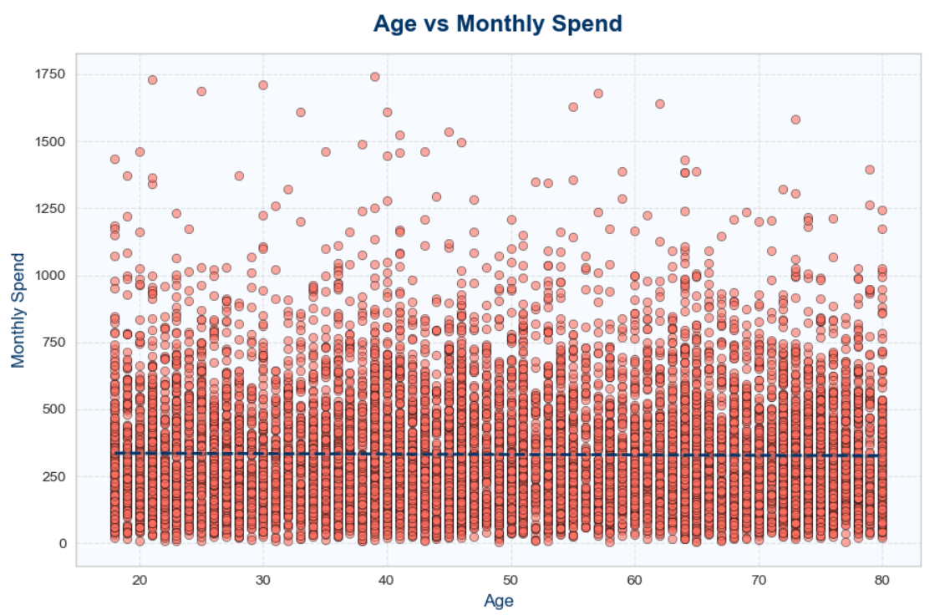
Age vs Monthly Spend — Analytical Insight
Correlation (-0.01): The near-zero value indicates no meaningful relationship between age and spending.
Trend Line: The regression line is almost flat, confirming that spending patterns are independent of age.
Data Spread: Spending values are widely distributed across all age groups, with both younger and older customers showing similar variability.
Outliers: High spenders appear across different ages, suggesting that premium customers are not concentrated in any specific age bracket.
Key Observations:
Age does not drive monthly spending behavior — customers of all ages exhibit similar spending ranges.
High-value customers are scattered across age groups, meaning age-based segmentation alone is insufficient for targeting premium spenders.

Slide 11
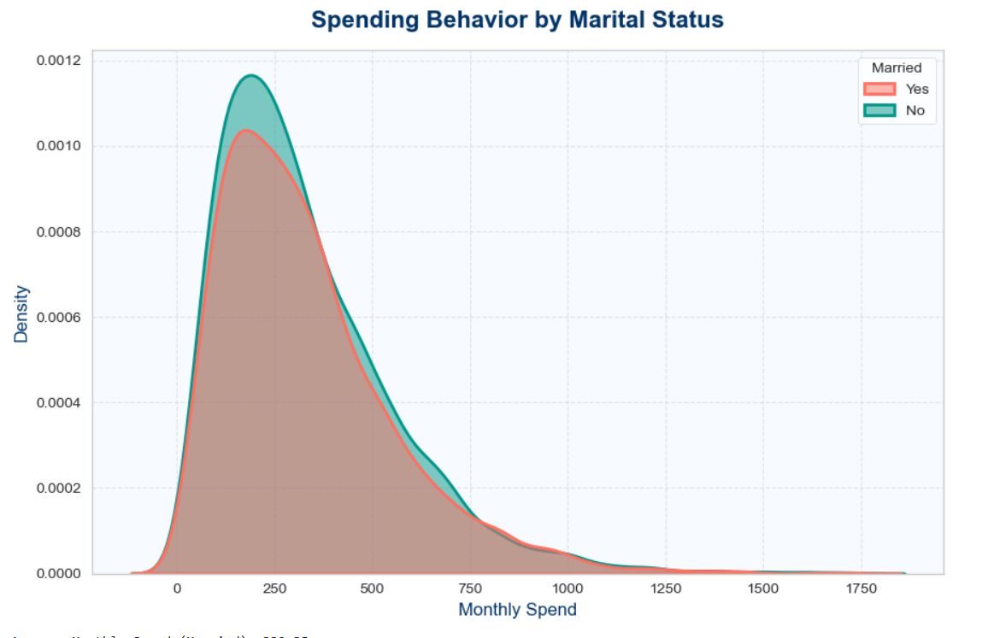
Spending Behavior by Marital Status
Average Spend:
Married → USD332.35
Not Married → USD330.94 The averages are nearly identical, showing no significant difference in spending behavior.
Distribution Shape: Both groups peak around USD250 monthly spend, with similar spread and tapering at higher values.
Overlap: The curves overlap almost entirely, indicating that marital status does not strongly influence spending.
Key Observations:
Spending behavior is consistent across marital status groups.
High spenders exist in both categories, suggesting premium customers are not concentrated in one group.
Marital status is not a strong predictor of monthly spend.

Slide 12
Bivariate Analysis

Slide 13
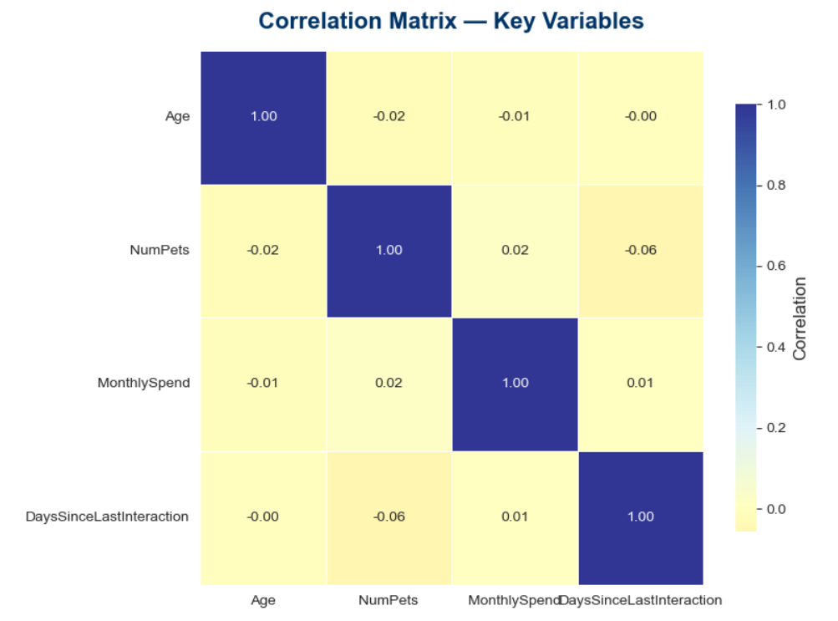
Correlation Matrix
Age vs Monthly Spend (-0.01): No meaningful correlation; spending is independent of age.
Age vs NumPets (-0.02): Negligible relationship; pet ownership does not vary with age.
NumPets vs Monthly Spend (0.02): Very weak positive correlation; owning more pets does not significantly increase spending.
NumPets vs Days Since Last Interaction (-0.06): Slight negative correlation; customers with more pets may interact marginally more frequently.
Monthly Spend vs Days Since Last Interaction (0.01): No significant relationship; spending is not tied to recency of interaction.

Slide 14
Correlation Matrix — Analytical Insight
Key Observations:
All correlations are close to zero, indicating that these variables are largely independent.
No strong linear relationships exist, meaning predictive models should not rely on these variables alone.
Behavioral and transactional features (e.g., frequency of purchases, product categories) may provide stronger signals than demographic attributes.
Business Insight: Since demographic factors (age, pets) and interaction recency show minimal correlation with spending, segmentation strategies should focus on behavioral drivers. Advanced techniques like clustering or RFM (Recency, Frequency, Monetary) analysis may yield more actionable insights than relying on simple correlations.

Slide 15
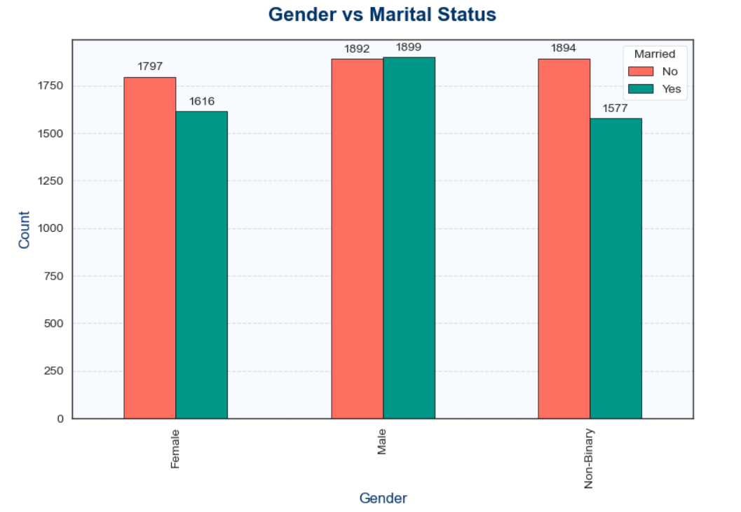
Gender vs Marital Status
Female:
Not Married → 1797
Married → 1616 Slightly more females are unmarried, showing a modest gap.
Male:
Not Married → 1892
Married → 1899 Counts are nearly equal, indicating balanced representation.
Non-Binary:
Not Married → 1894
Married → 1577 Noticeable difference, with more individuals identifying as non-binary being unmarried.

Slide 16
Gender vs Marital Status — Analytical Insight
Key Observations:
Males show the most balanced split between married and unmarried.
Females and Non-Binary groups lean toward being unmarried, though the difference is not extreme.
Overall, marital status distribution is relatively balanced across genders, with no overwhelming skew.
Business Insight: Marital status does not drastically differ across genders, but slight variations exist.
Campaigns targeting family-oriented products/services may resonate more with married males.
Lifestyle or independent offerings could be positioned toward unmarried females and non-binary customers.
Inclusive strategies should ensure messaging reflects both married and unmarried segments across all genders.

Slide 17
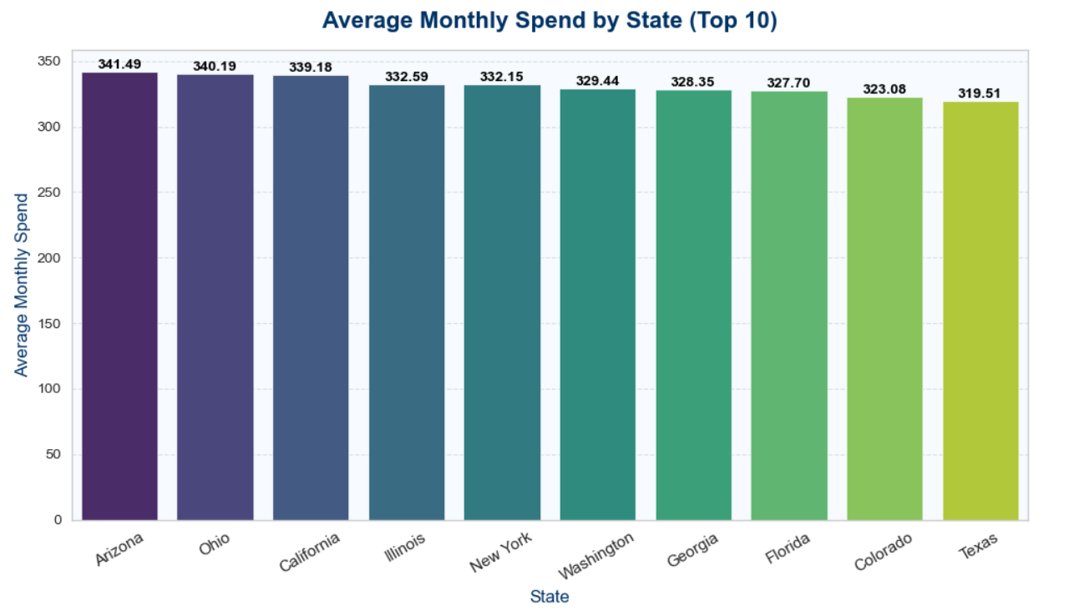
Average Monthly Spend by State
Arizona (USD341.49) → Highest average spend, indicating a premium market.
Ohio (USD340.19) & California (USD339.18) → Close behind Arizona, strong high-value markets.
Illinois (USD332.59) & New York (USD332.15) → Mid-tier but still above USD330 average spend.
Washington (USD329.44), Georgia (USD328.35), Florida (USD327.70) → Consistent spending levels, slightly lower but stable.
Colorado (USD323.08) & Texas (USD319.51) → Lowest among the top 10, yet still significant contributors.

Slide 18
Average Monthly Spend by State — Analytical Insight
Key Observations:
Spending differences across states are relatively small, clustered between USD319–USD341.
Arizona leads, but Ohio and California are nearly equal, suggesting multiple strong premium markets.
The spread shows broad regional spending power, not concentrated in one state.
Business Insight:
Prioritize Arizona, Ohio, and California for premium product launches or high-value campaigns.
Maintain strong engagement in Illinois and New York, which show solid mid-tier spending.
Explore opportunities to boost spending in Texas and Colorado, where averages are slightly lower but customer bases remain large.

Slide 19
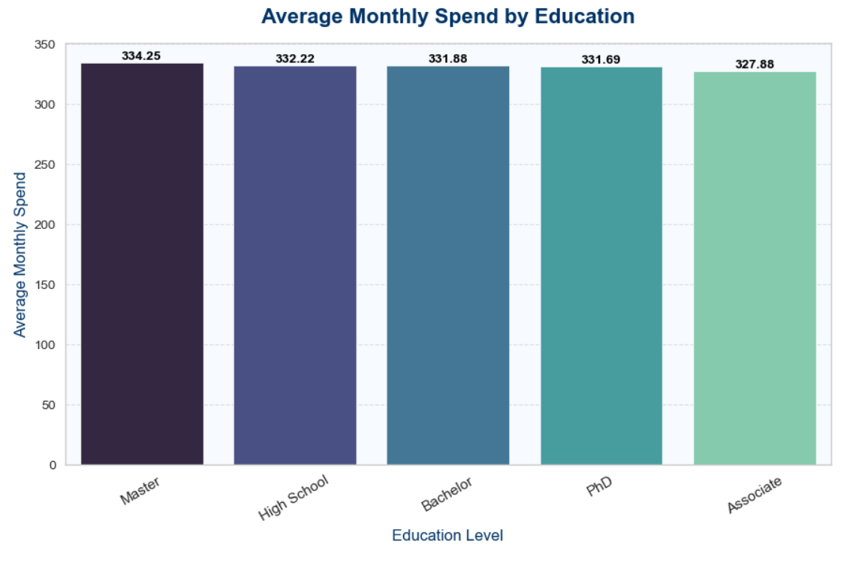
Average Monthly Spend by Education
Master (USD334.25) → Highest average spend, indicating stronger purchasing power.
High School (USD332.22) → Surprisingly close to Master, showing that spending is not strictly tied to higher education.
Bachelor (USD331.88) & PhD (USD331.69) → Mid-range spenders, nearly identical averages.
Associate (USD327.88) → Lowest average spend, though only marginally below other groups

Slide 20
Average Monthly Spend by Education — Analytical Insight
Key Observations:
Spending differences across education levels are minimal, clustered between USD327–USD334.
Master’s degree holders lead slightly, but the gap is not large enough to suggest strong education-based segmentation.
The closeness of High School and advanced degrees (PhD, Master) highlights that education level is not a major driver of spending behavior.
Business Insight: Marketing strategies should not rely heavily on education segmentation, as spending patterns are broadly consistent. Instead:
Premium campaigns can target Master’s degree holders, but also include High School customers who show comparable spending.
Broad-based offers are effective across all education levels, since differences are marginal.
Focus on behavioral and lifestyle attributes (e.g., product preferences, frequency of purchases) for sharper segmentation.

